Slide 1
City Council Study Session Vehicle Miles Traveled (VMT) and Energy Conservation Action Strategy (ECAS)
January 26, 2021

Slide 2
VMT
01
Agenda Item 09C – VMT and ECAS – Slide 2 of 15

Slide 3
Topics Addressed at 1/19/21 Planning Commission Study Session
What is VMT and how is it calculated?
More specifics on Vacaville Travel Demand Model
Is Vacaville doing its “fair share” or even more in terms of VMT reduction?
Coordination efforts with the development community
More details on TDM effectiveness and emerging trends
Putting it all together: VMT vs. LOS, and GP Policies vs. CEQA (concerns raised on January 5th).
Agenda Item 09C – VMT and ECAS – Slide 3 of 15

Slide 4
Putting It All Together
VMT will be the primary metric used to evaluate project impacts on the transportation system under CEQA.
Project effects on other modes of transportation, emergency response, and hazardous conditions will also be evaluated.
LOS will continue to be a metric of interest to many decisionmakers and the public. However, it will not be found in EIRs.
Policies in City’s Transportation Element will be updated to reconcile changing roles of LOS and VMT.
Agenda Item 09C – VMT and ECAS – Slide 4 of 15

Slide 5
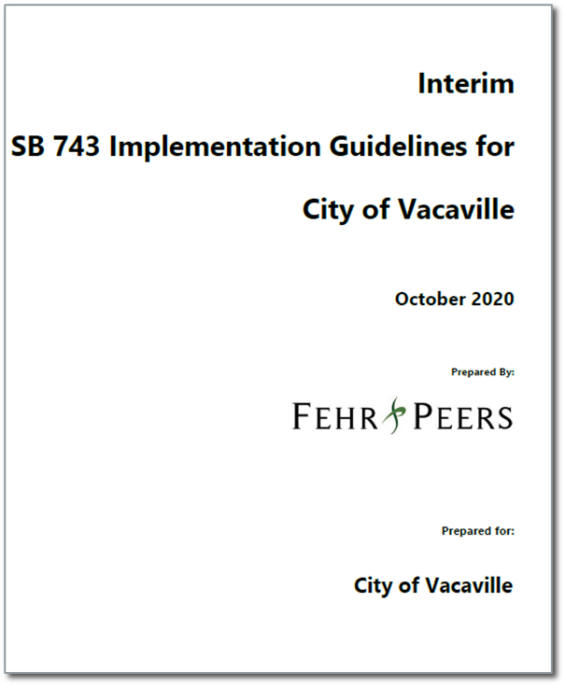
Putting It All Together (continued)
Checklist for VMT Thresholds of Significance for Land Use Projects
Many Exemptions (VMT impacts presumed less-than-significant)
Small Projects: up to 11 single-family units or 10,000 sq. ft. office
Projects near High-Quality Transit
Affordable Housing
Redevelopment Projects: project results in a net decrease in VMT.
Local-Serving Retail: Projects of 50,000 sq. ft retail space or less.
Agenda Item 09C – VMT and ECAS – Slide 5 of 15

Slide 6
Putting It All Together (continued)
Checklist for VMT Thresholds of Significance for Land Use Projects
Project Screening
Projects that are situated in “low VMT generating” areas of the City are presumed less-than-significant.
Projects Consistent with General Plan
Will not require further VMT analysis, pursuant to the tiering provisions of CEQA (Section 15183). However, they must still implement feasible mitigation measures to offset VMT impacts.
Agenda Item 09C – VMT and ECAS – Slide 6 of 15

Slide 7
ECAS
02
Agenda Item 09C – VMT and ECAS – Slide 7 of 15

Slide 8
2035 GHG Emission Inventory
Agenda Item 09C – VMT and ECAS – Slide 8 of 15

Slide 9
Reductions - Energy
Local
Buy renewable energy
Energy audits at sale
All electric construction
State
Net zero building code
Renewable Portfolio Standard
Agenda Item 09C – VMT and ECAS – Slide 9 of 15

Slide 10
Reductions - Transportation
Local
Telecommuting
Providing charging stations
Alternative fuel construction equipment
Transportation demand management
State
Clean cars and fuels
Agenda Item 09C – VMT and ECAS – Slide 10 of 15
Notes:
TDM = paid off street, transit improvements, transit subsides, vanpool incentives (all F&P). Res, office, industrial, and retail

Slide 11
Reductions – Waste
Local
Organics waste reduction plan
State
None
Agenda Item 09C – VMT and ECAS – Slide 11 of 15
Notes:
TDM = paid off street, transit improvements, transit subsides, vanpool incentives (all F&P). Res, office, industrial, and retail

Slide 12
Reductions – Carbon Sequestration
Local
Tree planting
State
None
Agenda Item 09C – VMT and ECAS – Slide 12 of 15
Notes:
TDM = paid off street, transit improvements, transit subsides, vanpool incentives (all F&P). Res, office, industrial, and retail

Slide 13
Discussion and Public Comment
03
Agenda Item 09C – VMT and ECAS – Slide 13 of 15

Slide 14
Next Steps
04
Agenda Item 09C – VMT and ECAS – Slide 14 of 15

Slide 15
New Topics
How will SB 743 impact affordable housing?
How will General Plan Amendments be processed?
Is development being treated equitably?
What are some reasonable TDM strategies the City could impose that are effective?
Agenda Item 09C – VMT and ECAS – Slide 15 of 15
Notes:
TDM = paid off street, transit improvements, transit subsides, vanpool incentives (all F&P). Res, office, industrial, and retail

