Slide 1
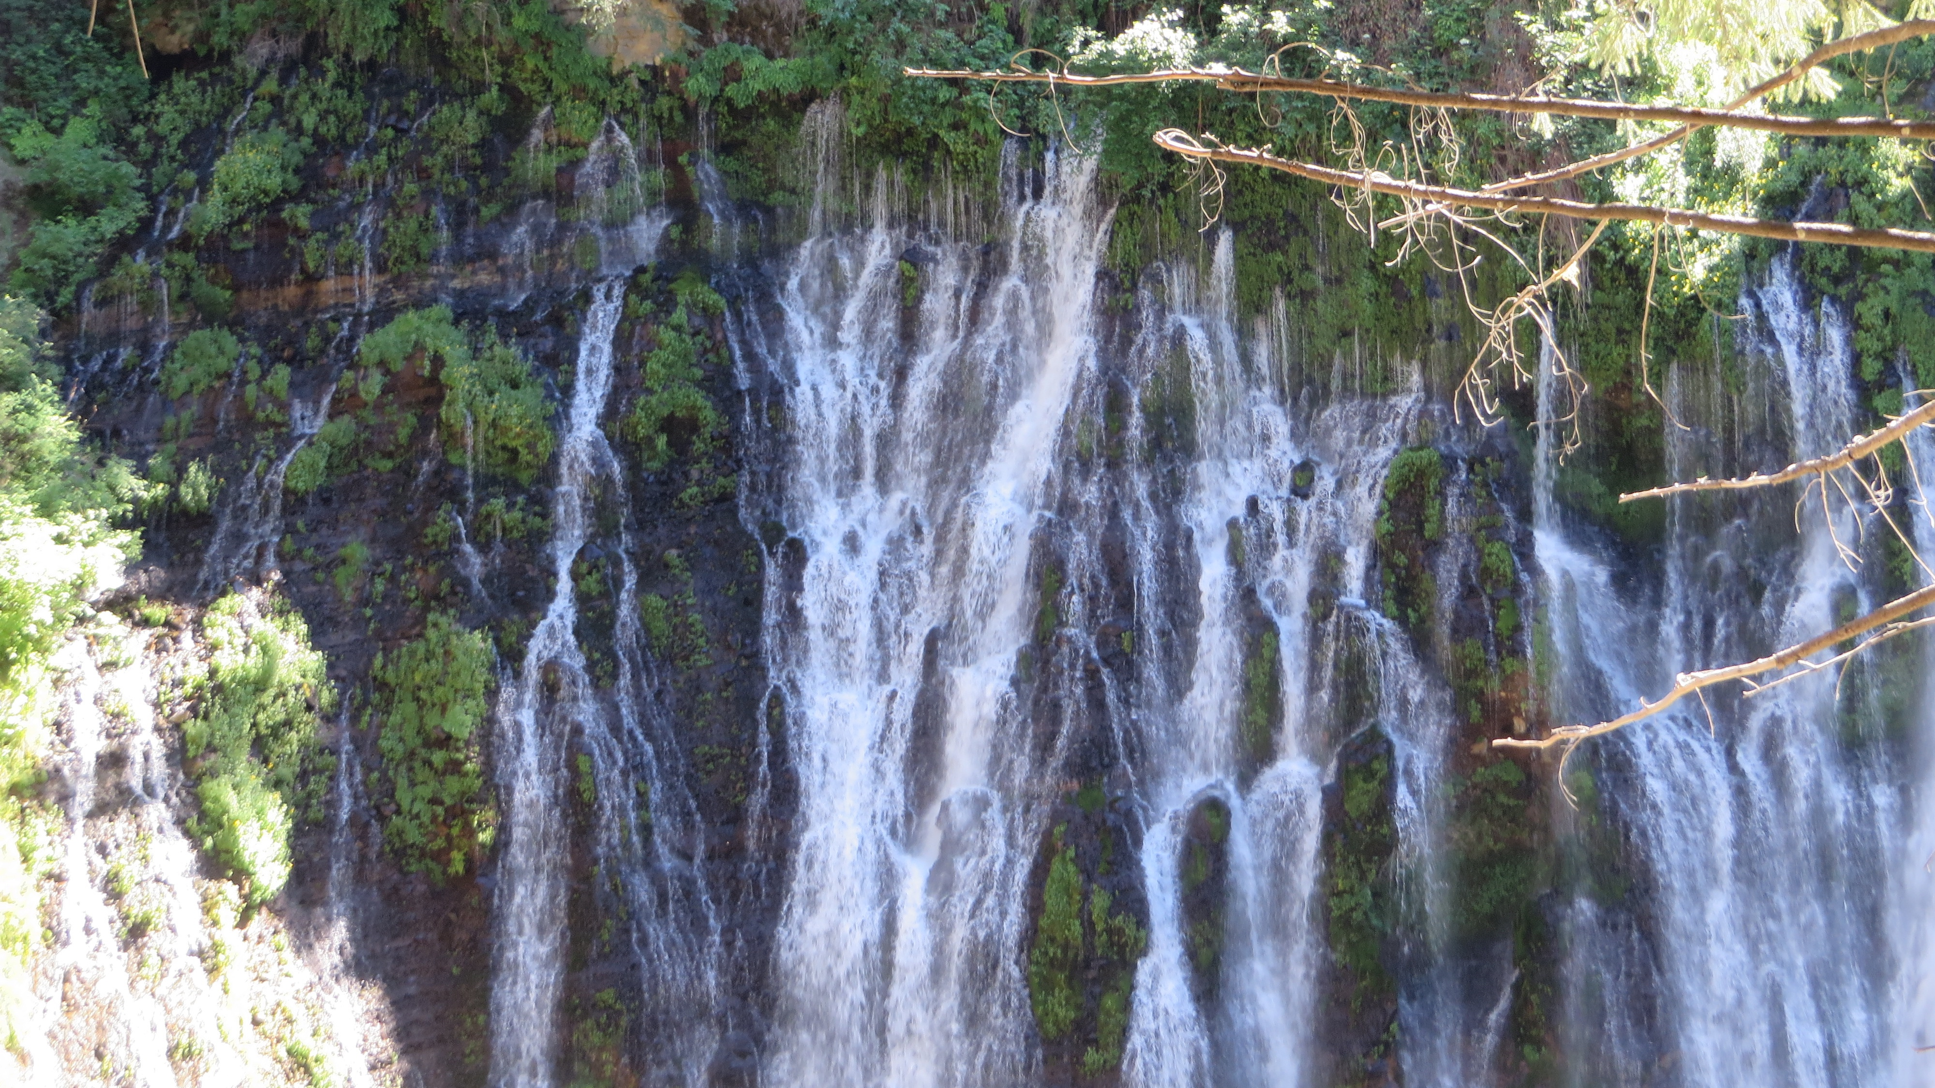
Planning Commission Study Session
VEHCILE MILES TRAVELED (VMT) POLICY AND ENERGY AND CONSERVATION ACTION STRATEGY (ECAS)
To change the background image:
right click>change picture
TIP: Remember to always scale images from the corner.
January 5, 2021
Notes:
You change this background image by:
right click>change picture
TIP: Remember to always scale images from the corner.

Slide 2
Overview
01
VMT and SB 743
04
Public Comment
02
ECAS Update
05
Next Steps
03
Commission Discussion
Notes:
You can change this background photo in the Master template
View>Slide Master

Slide 3
VMT and SB 743
01
Notes:
You can change this background photo in the Master template
View>Slide Master

Slide 4

Regulatory Background Overview
SB 743
  PRC Section 21099(b) and (c) – change transportation analysis in CEQA from LOS to VMT to better align with State goals to reduce GHG, encourage infill development, and improve public health through increased active transportation
  OPR December 2018 Technical Advisory on Evaluating Transportation Impacts in CEQA
  VMT analysis required statewide beginning July 1, 2020

Slide 5
Implementing VMT
Amend Transportation Element to identify VMT as the metric for environmental review of transportation impacts
  LOS would continue to be used in planning and design of transportation facilities (but would not be considered under CEQA)
  Emergency access and traffic hazards are still assessed
  Consistency with non-automobile transportation policies
Adopt state-recommended threshold
  15% reduction in VMT for residential projects, compared to the regional average
  15% reduction in VMT for employment generating projects, compared to the regional average
  No net increase in VMT for retail projects
  Assess “induced VMT” for transportation projects

Slide 6
Screening of VMT
If a proposed land development project:
  Meets VMT reduction threshold (screening maps); or
  is located within ½ mile of a major transit stop or a stop along a high transit corridor, or
  generates 110 trips per day, or
  100% affordable housing.
a less than significant transportation impact “should be presumed”

Slide 7
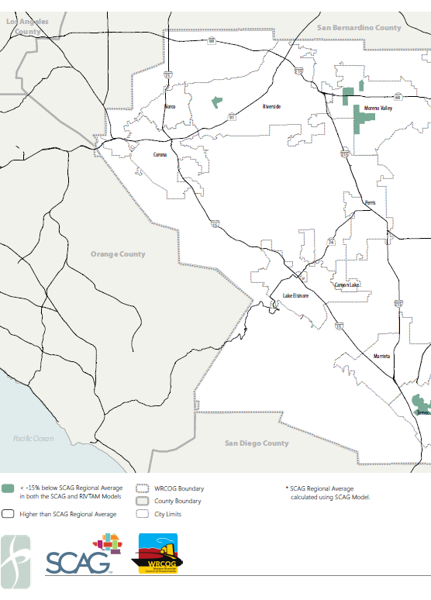
Screening Example
Low VMT Zones “15% Below
Threshold”

Slide 8
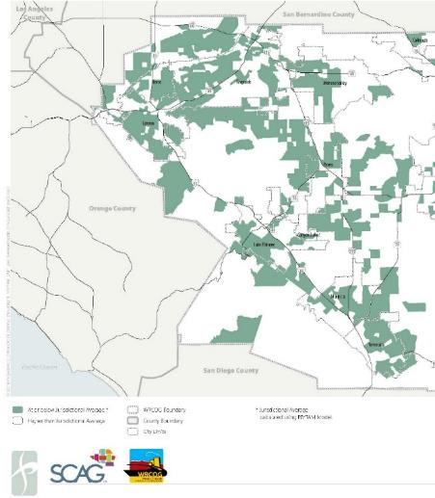
Screening Example
Low VMT Zones “Average Baseline
Threshold”

Slide 9
Impacts and Mitigation
VMT is primarily a function of location (land use). Project-level mitigation is typically in the form of transportation demand management (TDM) measures.
Where projects are not in “screened” areas that meet the VMT threshold, and TDM is insufficient to meet the threshold, a significant and unavoidable impact would be identified
  Normally would require preparation of an EIR
  A Statement of Overriding Consideration must be adopted if the project is approved
  A Supplement to the General Plan EIR is being prepared to streamline this process for projects that are consistent with the General Plan

Slide 10
TDM Measures
Improving access to transit;
increasing access to common goods and services, such as groceries, schools, and daycare;
incorporating affordable housing into the project;
incorporating neighborhood electric vehicle network;
orienting the project toward transit, bicycle and pedestrian facilities;
improving pedestrian or bicycle networks, or transit service;
implementing traffic calming;
providing bicycle parking;
unbundling parking costs;
providing parking cash-out programs;
implementing a commuter reduction program;
providing car-sharing, bike sharing, and ride-sharing programs;
providing transit subsidies or passes;
providing ride-matching services;
providing telework options;
providing incentives or subsidies that increase the use of modes other than single-occupant vehicle;
providing on-site amenities at places of work, such as priority parking for carpools and vanpools, secure bike parking, and showers and locker rooms;
providing employee transportation coordinators at employment sites;
providing a guaranteed ride home service to users of non-auto modes;
increasing project density;
increasing the mix of uses within the project or within the project’s surroundings; and/or
increasing connectivity and/or intersection density on the project site.

Slide 11
ECAS Update
02
Notes:
You can change this background photo in the Master template
View>Slide Master

Slide 12
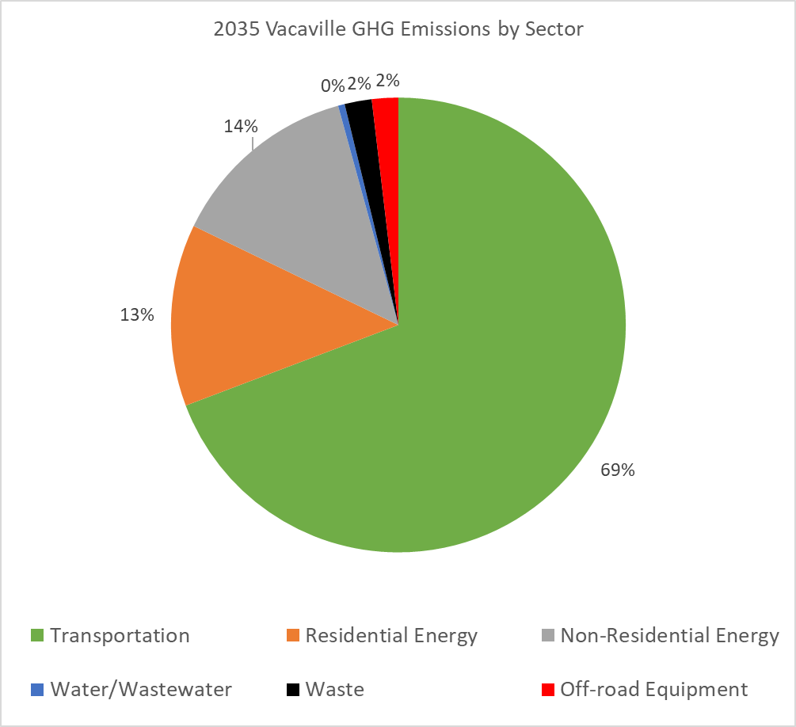
Greenhouse Gasses
Transportation
  VMT
  Fuel type
Energy
  Electricity
  Natural gas
Solid Waste
Water/Wastewater

Slide 13
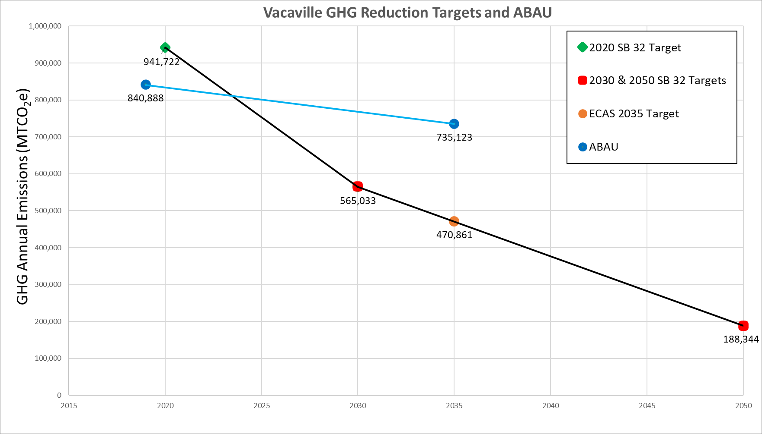
Reduction Targets

Slide 14
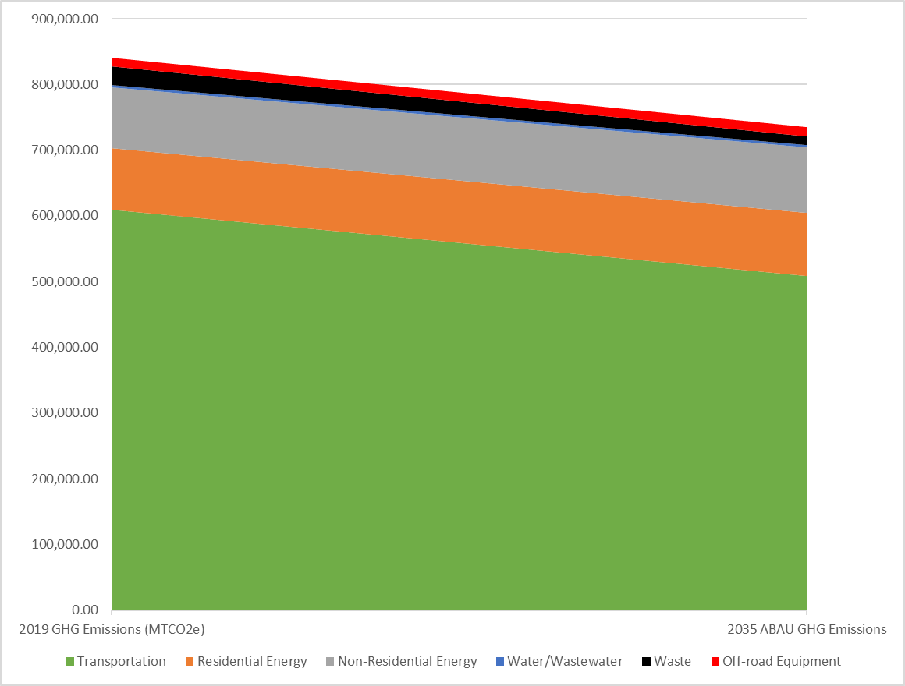
Reduction Targets

Slide 15
Greenhouse Gasses
GHG Reduction
  Source
  Measurable and enforceable
Cost
  To developers
  To residents
  Avoided cost
Feasibility
  Automatic or behavior change
  Co-benefits

Slide 16
Commission Discussion
03
Notes:
You can change this background photo in the Master template
View>Slide Master

Slide 17
Public Comment
04
Notes:
You can change this background photo in the Master template
View>Slide Master

Slide 18
Next Steps
05
Notes:
You can change this background photo in the Master template
View>Slide Master

