Slide 1
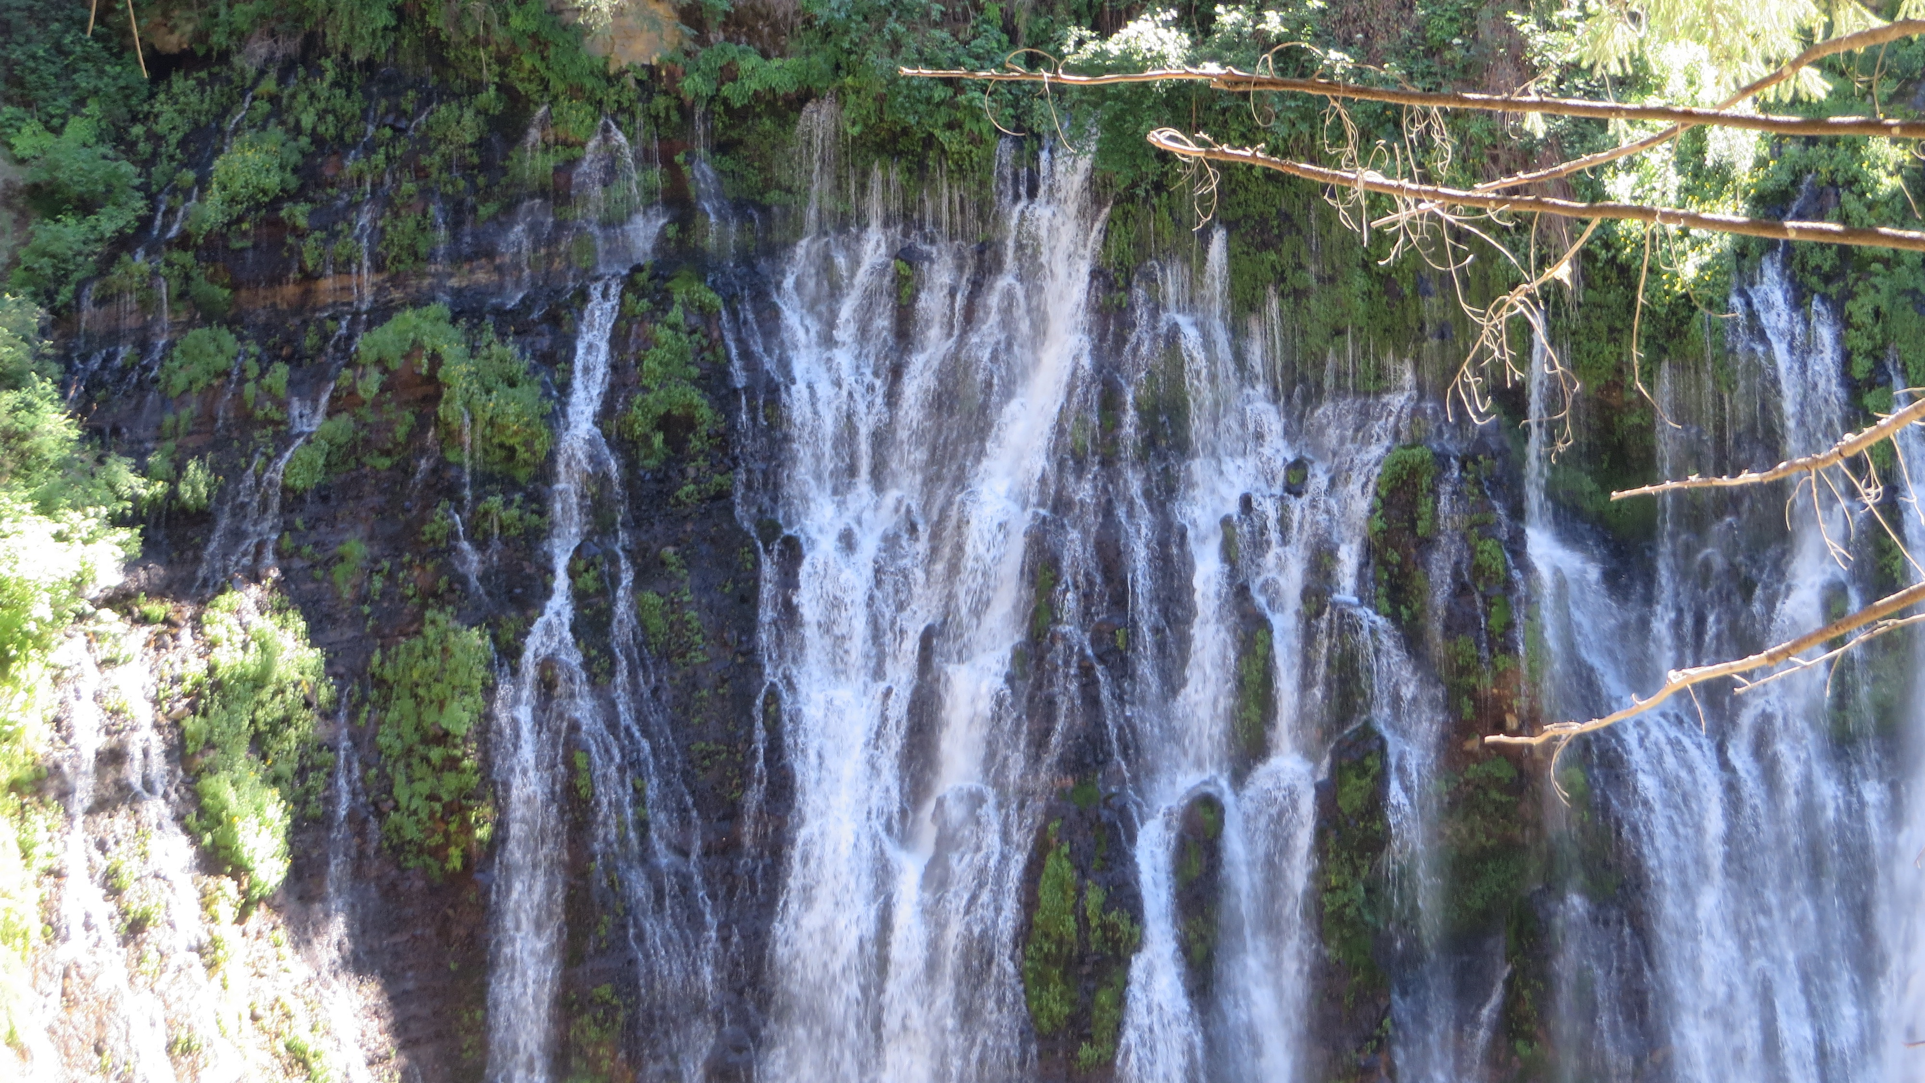
Planning Commission Study Session IN-DEPTH VEHICLE MILES TRAVELED (VMT) DISCUSSION
To change the background image: right click>change picture TIP: Remember to always scale images from the corner.
January 19, 2021
Notes:
You change this background image by: right click>change picture
TIP: Remember to always scale images from the corner.

Slide 2
Topics Covered on January 5, 2021
Intent of Senate Bill (SB) 743
Land Use Projects whose VMT Impacts are Presumed Less-Than-Significant
Exemptions: small projects, near high-quality transit, affordable housing, redevelopment, and locally-serving retail.
Projects in VMT-efficient areas (i.e., screening maps)
Overview of City of Vacaville Travel Demand Model
“Partial” discussion of Transportation Demand Management (TDM) Strategies
Notes:
No reason to rehash these in detail. But available to answer questions if needed.

Slide 3
VMT Topics Needing Greater Coverage
What is VMT and How is it Calculated?
More Specifics on Vacaville Travel Demand Model
Is Vacaville doing its “fair share” or even more in terms of VMT reduction?
Coordination Efforts with the Development Community
More Details on TDM Effectiveness and Emerging Trends
Putting it All Together: VMT vs. LOS, and GP Policies vs. CEQA (i.e., concerns raised on January 5th).
Notes:
Watched 1/5 PC hearing, and the following were outstanding issues.

Slide 4
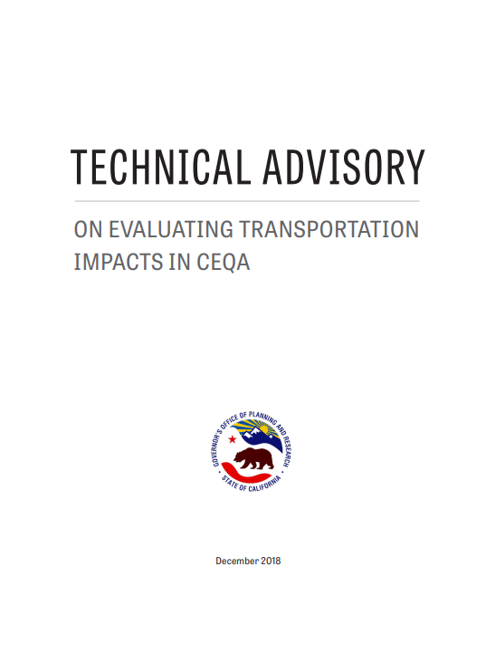
1. What is VMT and How is it Calculated?
By definition, one mile driven by a vehicle.
Almost always expressed as the amount of travel per day.
Often reported as an efficiency ratio: VMT per resident, per dwelling unit, per employee, or per ksf of office, etc.
Sometimes also expressed as a City-wide total representing all travel with trip origins/destinations in the City.
Per OPR’s Technical Advisory, full extent of trip is considered including length of trip beyond City limits.
Sometimes computed for all streets within a jurisdiction.
All VMT calculations in Vacaville rely on its travel demand model
Notes:
Watched 1/5 PC hearing, and the following were outstanding issues.

Slide 5
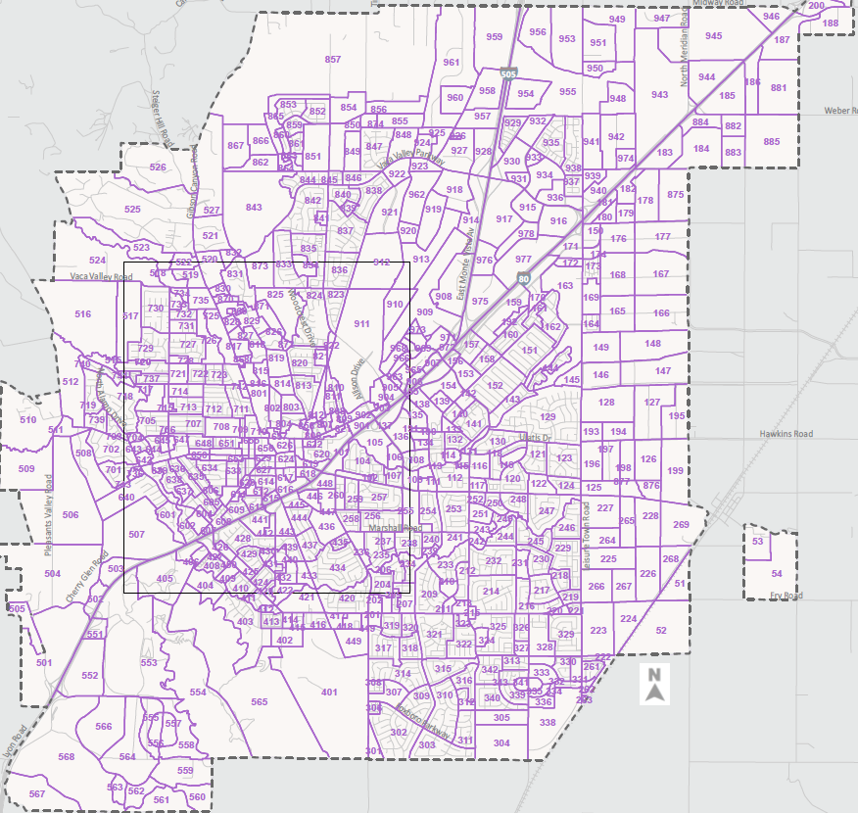
2. More Specifics On Vacaville Travel Demand Model
Base Year= 2015
Cumulative Year = Buildout Minus Northeast Area
Highly detailed model
Length of external trips appended using LEHD data.
74% of employed Vacaville residents work outside the City. Average trip is over 30 miles.
City’s General Plan and its cumulative model contemplates more non-residential growth to improve jobs/housing balance.
Notes:
Watched 1/5 PC hearing, and the following were outstanding issues.

Slide 6
3. Is Vacaville doing its “fair share” or even more in terms of VMT reduction?
Yes, based simply on this discussion and the City’s intent.
Many agencies have not even started.
Others are relying upon their advantageous geographic position.
4. Coordination Efforts with the Development Community
Has proactively occurred on several occasions.
Several project-level VMT analyses have also been conducted.
Notes:
Watched 1/5 PC hearing, and the following were outstanding issues.

Slide 7
5. More Details on TDM Effectiveness and Emerging Trends
TDM Effectiveness
SB 743 places a spotlight on effectiveness; becomes CEQA mitigation for VMT impacts
Research is often lacking
Effectiveness is context/tenant specific.
Previously discussed topics: parking reductions, parking pricing, telecommuting, bicycle/pedestrian improvements
Emerging Trends
Post-COVID changes in travel: commute pattern changes
Internet shopping, new forms of travel (e.g., e-scooters)
Notes:
Watched 1/5 PC hearing, and the following were outstanding issues.

Slide 8
6. Putting it All Together
LOS will continue to be a metric of interest to many decisionmakers and the public. However, it will not be found in EIRs.
Many agencies are now establishing a split-study approach:
VMT Study (included in CEQA document)
Local Transportation Analysis (for informational purposes, may be used to establish conditions of approval)
VMT will be the primary metric used to evaluate project impacts on the transportation system under CEQA. Project effects on other modes of transportation, emergency response, and hazardous conditions will also be evaluated.
Policies in City’s Transportation Element will be updated to reconcile changing roles of LOS and VMT.
Notes:
.e., how much longer will I wait at this light? What improvements are needed at __

Slide 9
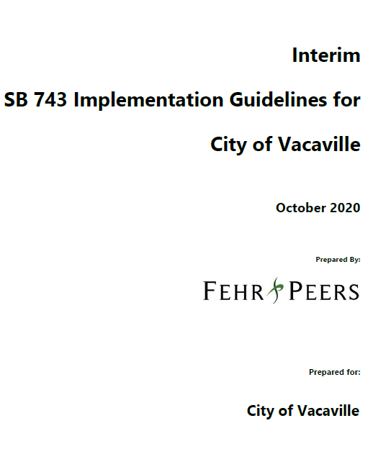
6. Putting it All Together
Checklist for VMT Thresholds of Significance for Land Use Projects
Many Exemptions (i.e., VMT impacts presumed less-than-significant)
Small Projects: up to 11 single-family units or 10,000 sq. ft. office
Projects near High-Quality Transit
Affordable Housing
Redevelopment Projects: project results in a net decrease in VMT.
Local-Serving Retail: Projects of 50,000 sq. ft retail space or less.
Project Screening
Projects that are situated in “low VMT generating” areas of the City are presumed less-than-significant.
Projects Consistent with General Plan
Will not require further VMT analysis, pursuant to the tiering provisions of CEQA (Section 15183). However, they must still implement feasible mitigation measures to offset VMT impacts.
Notes:
.e., how much longer will I wait at this light? What improvements are needed at __

Slide 10
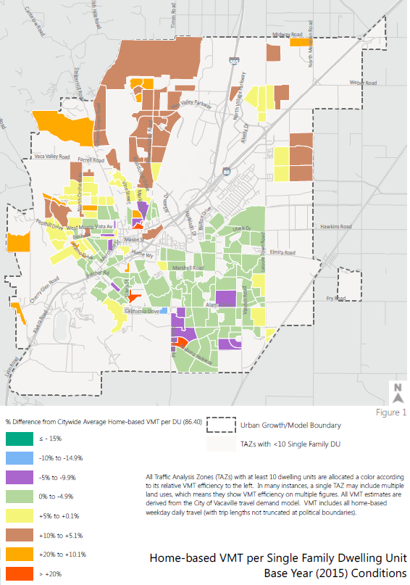
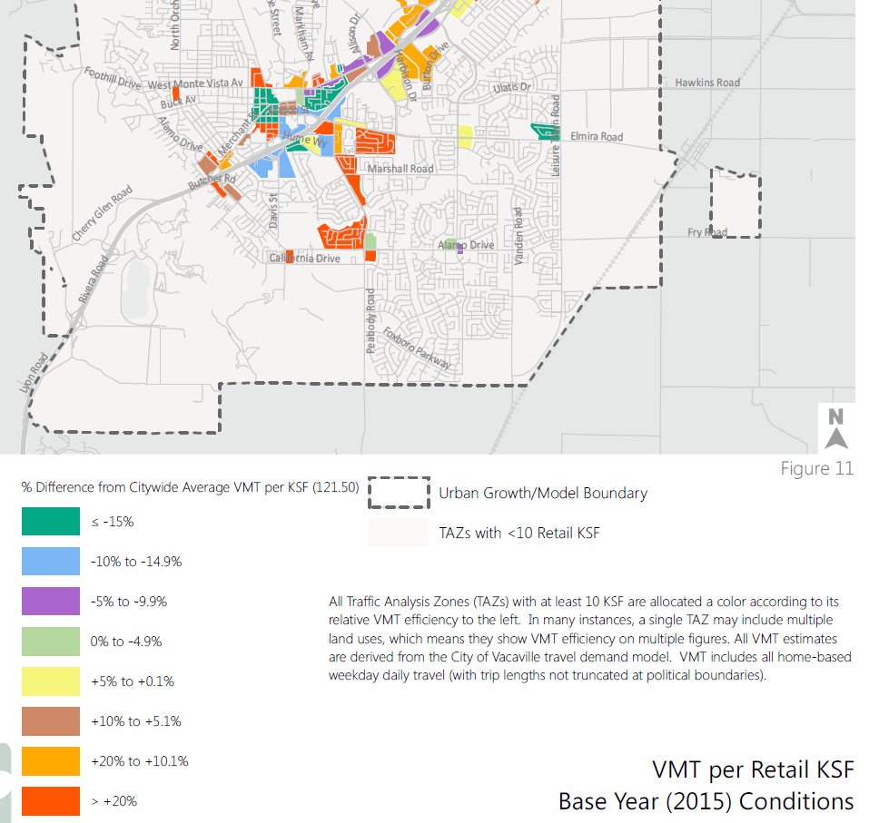
Screening Maps

Slide 11
Questions and Answers
Notes:
.e., how much longer will I wait at this light? What improvements are needed at __

